Slide 1
Group 4
Zac Cooper
Doug Simpson
Heather Bishop

Slide 2
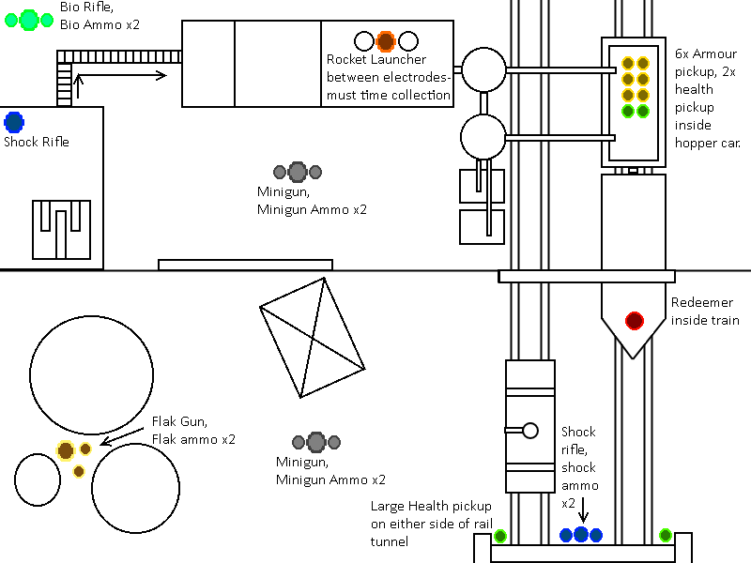
Design One
Floor Plan

Slide 3

Design One
Visual Feel

Slide 4
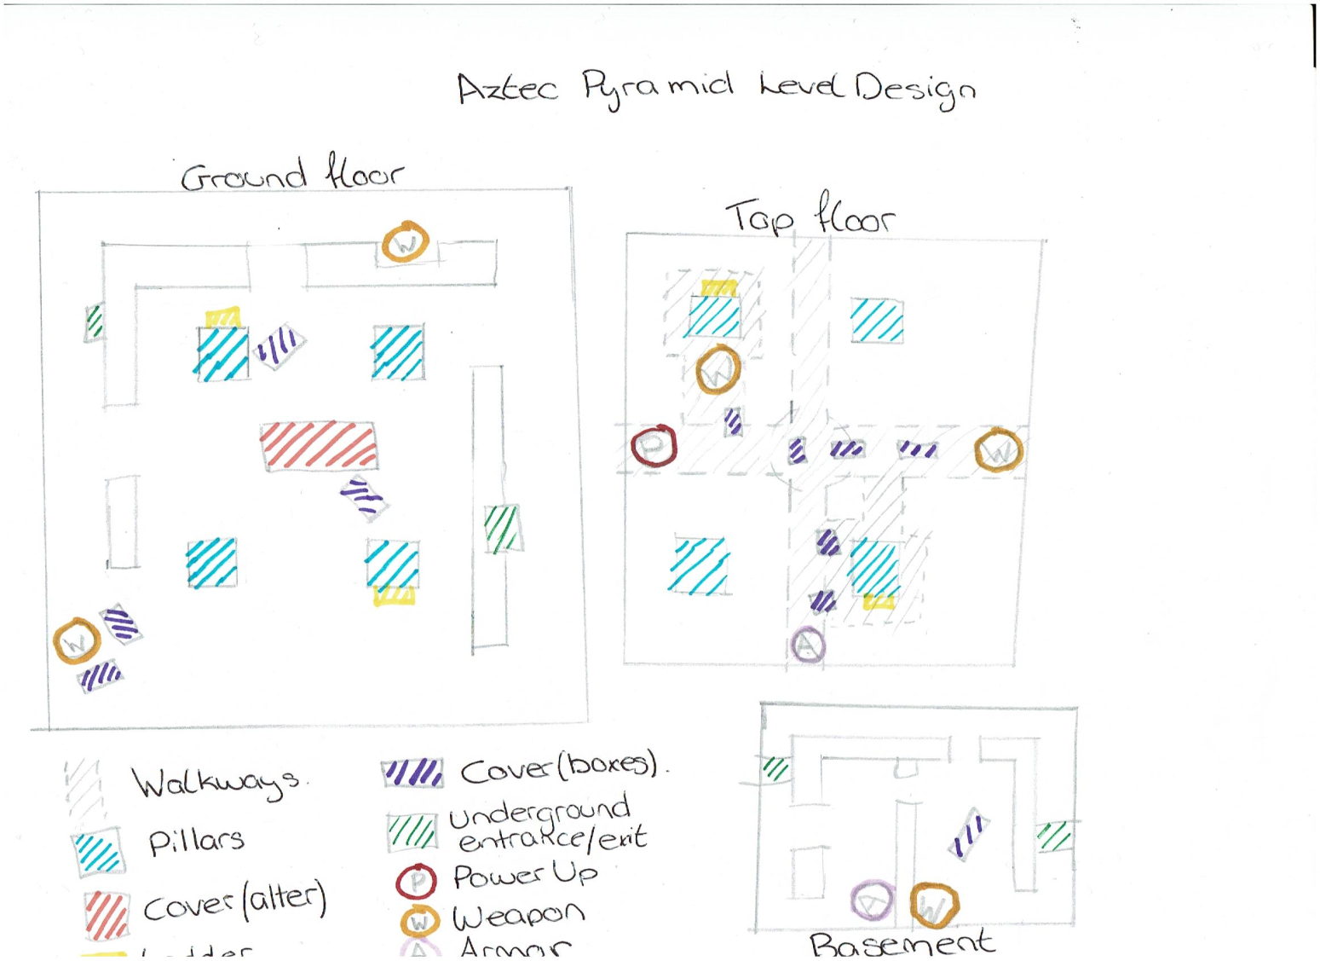
Design Two
Floor Plan

Slide 5

Design Two
Visual Feel

Slide 6
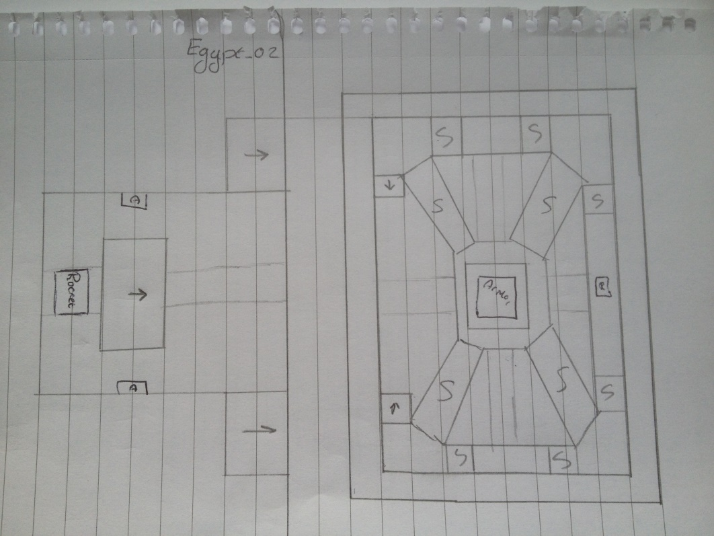
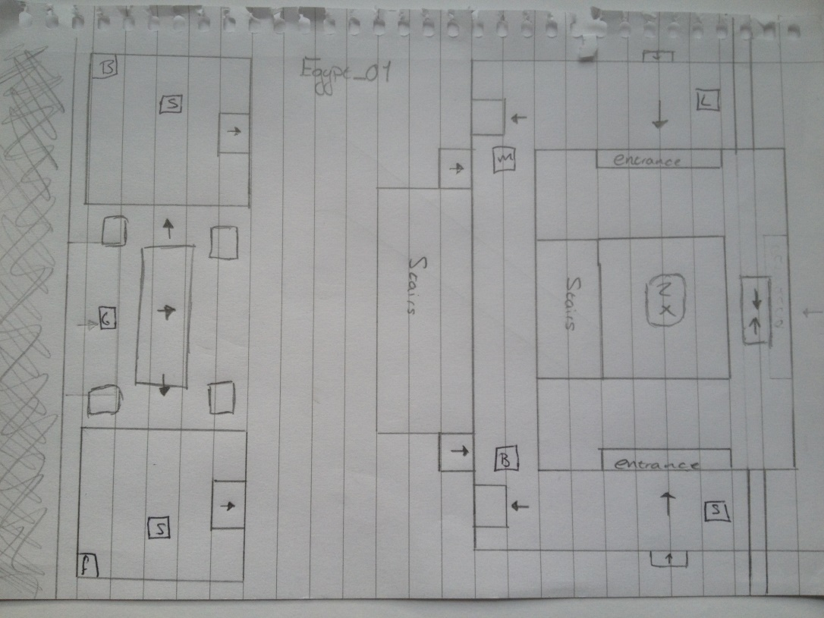
Design Three
Floor Plan

Slide 7

Design Three
Visual Feel

Slide 8
References
De Jong, S. (2008) The Hows and Whys of Level Design. Second edition. Raleigh. Lulu.
Totten (2014) An Architectural Approach to Level Design. London. CRC Press.
Miller, Mary (1986) The Art of Mesoamerica. London. Thames and Hudson.

Slide 9
Questions?

